Slide 1
Group 4:
Raghav Chopra (C0772292)
Project: Iot Based Smart Garage Door Opener

Slide 2
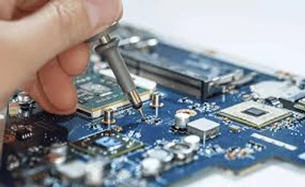
TESTING OF HARDWARE COMPONENTS:

Slide 3
Content: Testing Of Hardware Components
BeagleBone Black
Keypad 4*4 matrix
ESP32 wifi Module
Multimeter
Push button

Slide 4
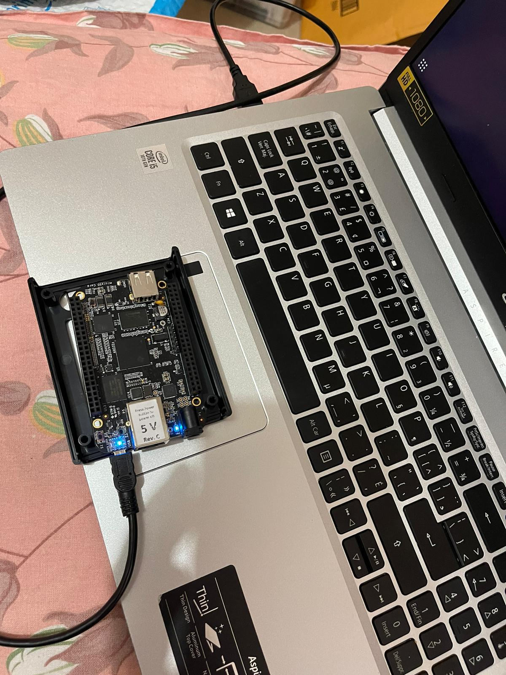
TESTING BEAGLEBONE BLACK
Connected the beaglebone black to the laptop using a USB connector.
Log in as debian@beaglebone using ssh debian@192.168.7.2 command on the terminal and its password is temppwd.
Check the linux kernel by using the command uname -a.

Slide 5
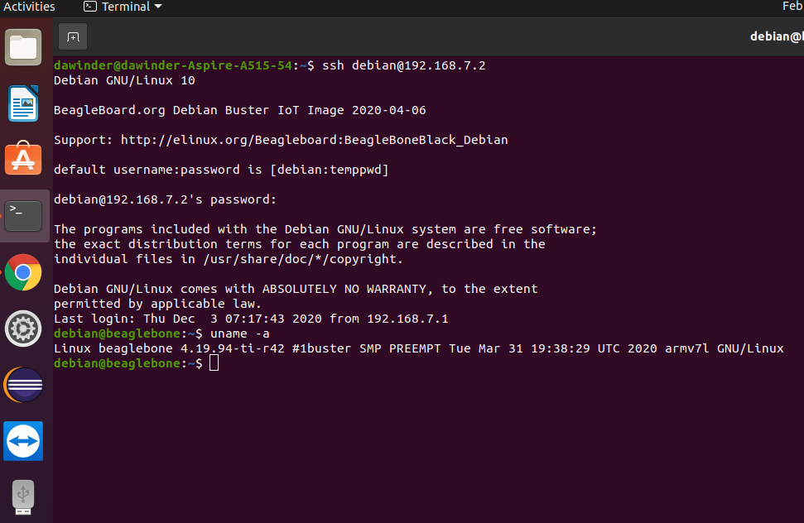
Testing Beaglebone Black

Slide 6
TESTING KEYPAD 4*4 MATRIX
In our project, we are using keypad for entering the password at the time of door opening and closing and this component is interfaced with arduino.

Slide 7
Connections of Keypad with Arduino for testing
Keypad Arduino
Ground Ground
VCC 5V
Row Pins Pins (9, 8, 7, 6)
Column Pins Pins (5, 4, 3, 2)

Slide 8
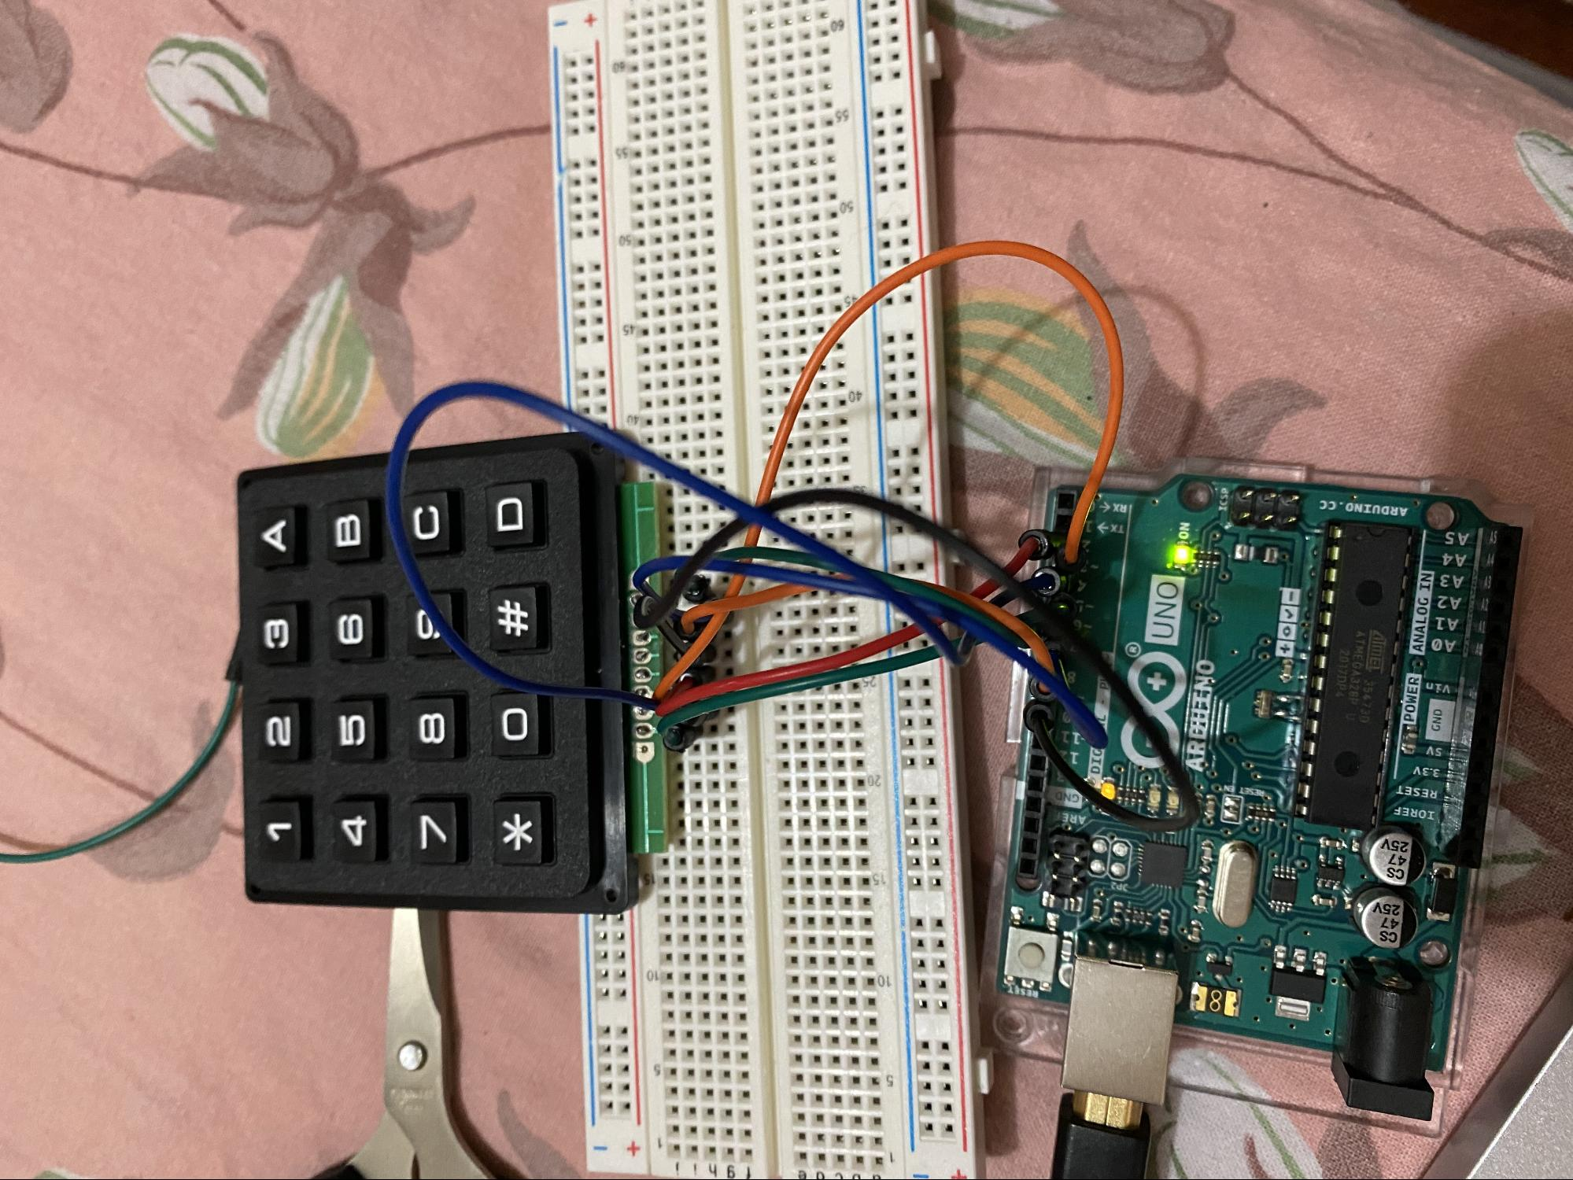
Testing of Keypad 4*4 matrix
Connected Arduino directly to the laptop via USB cable.
Jumper wires has been used to connect the rows and columns of keypad to the arduino.
Then keypad libraries has been installed in arduino ide.
After that we ran a simple program to test it.

Slide 9
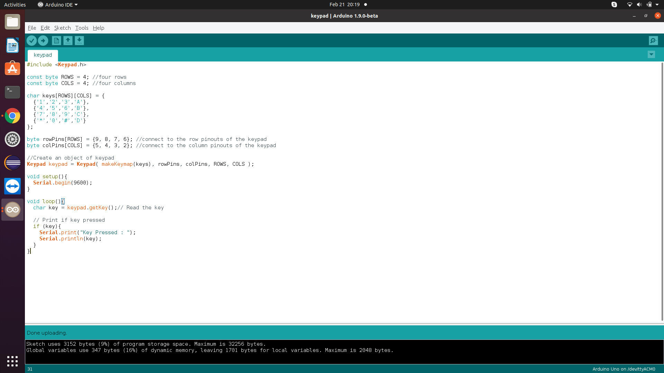
Testing of Keypad 4*4 matrix

Slide 10
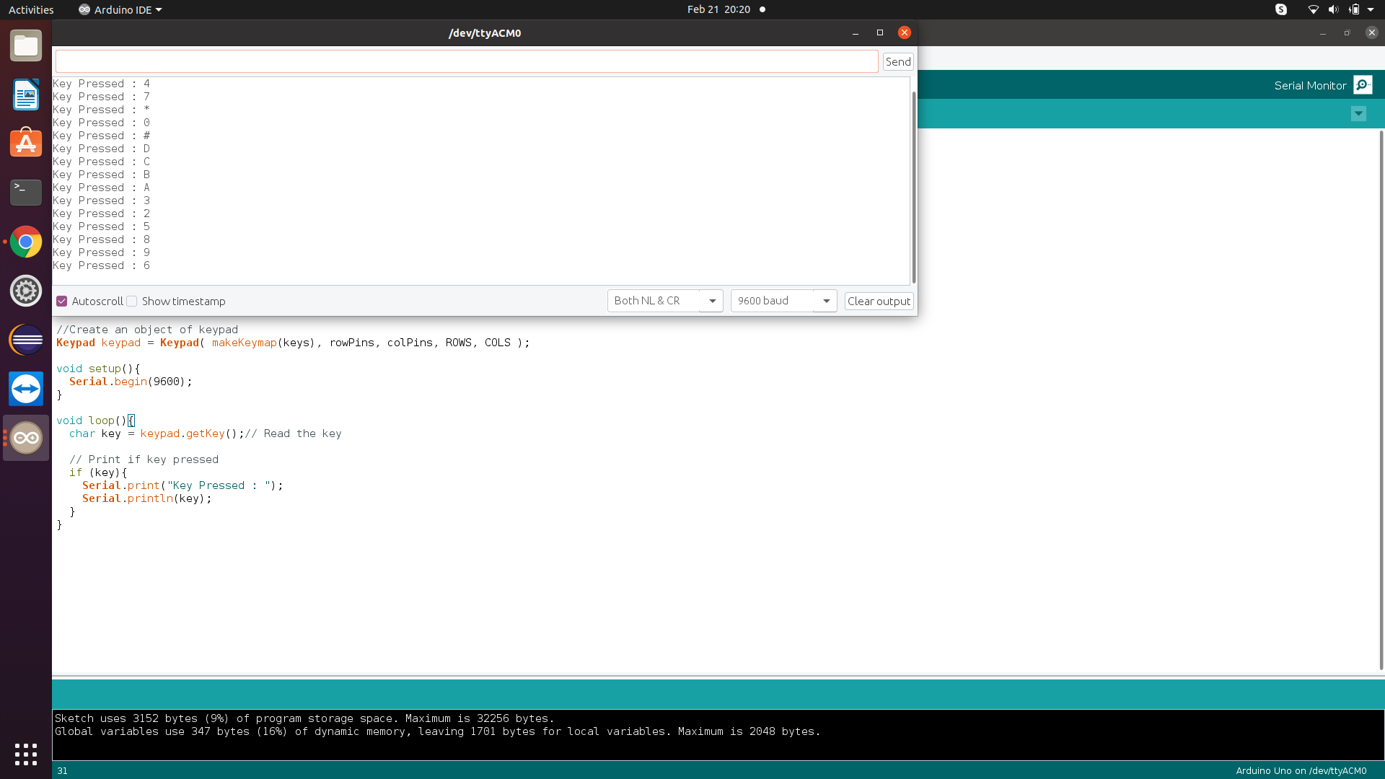
Testing of Keypad 4*4 Matrix

Slide 11
TESTING OF ESP32 WIFI MODULE
In our project, we are using Beaglebone Black which do not have inbuilt Wifi module therefore, we are using ESP32 for internet services. We will connect ESP32 directly to our laptop. We download libraries of ESP32 in Arduino IDE and then ran a simple program.

Slide 12
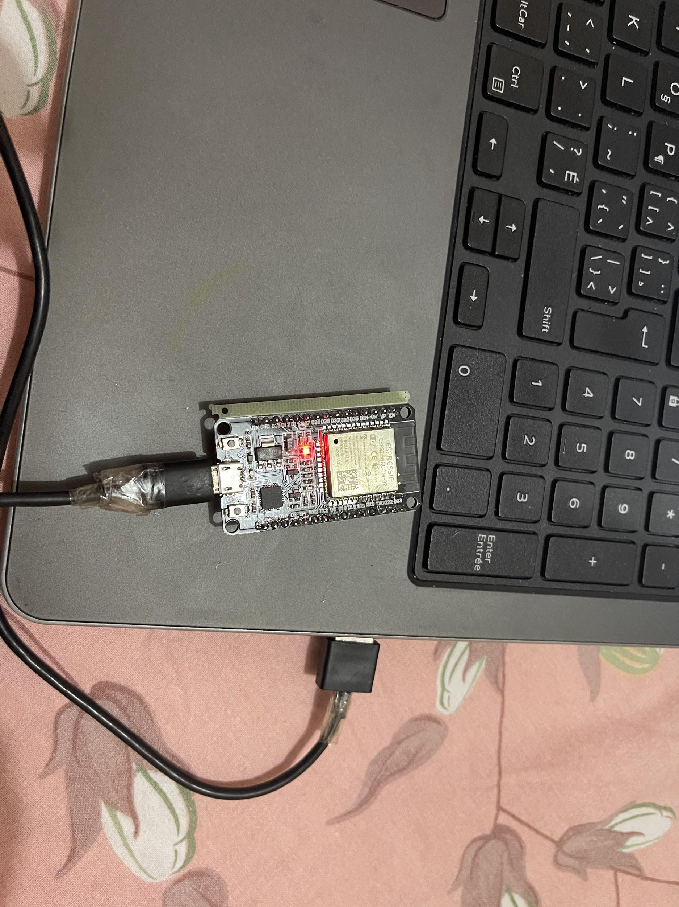
Testing of ESP32 with Arduino

Slide 13
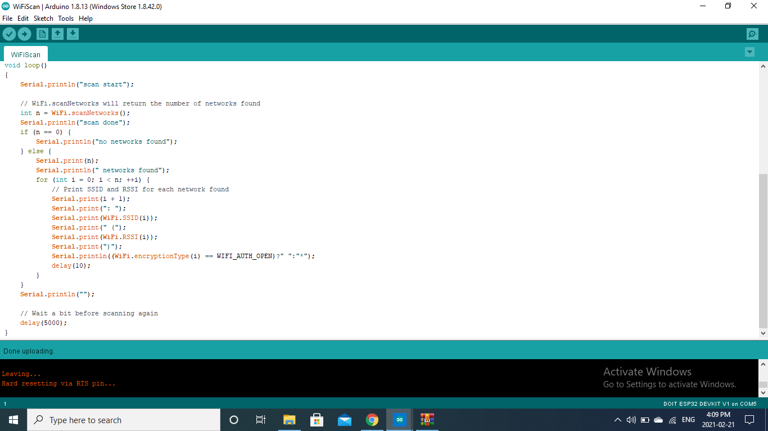
Testing of ESP32 with Arduino

Slide 14
TESTING OF Push button
Push button is simply a button which is used to control the some aspect of a process. In our project, we are using the push button in order to disable the buzzer if it beeps for so long or it is not required.

Slide 15
Connections of Push button
Ground of LED to Arduino GND
LED Positive to Arduino pin 13
Arduino digital pin 2 to push button positive
Push button Ground to Arduino Ground

Slide 16
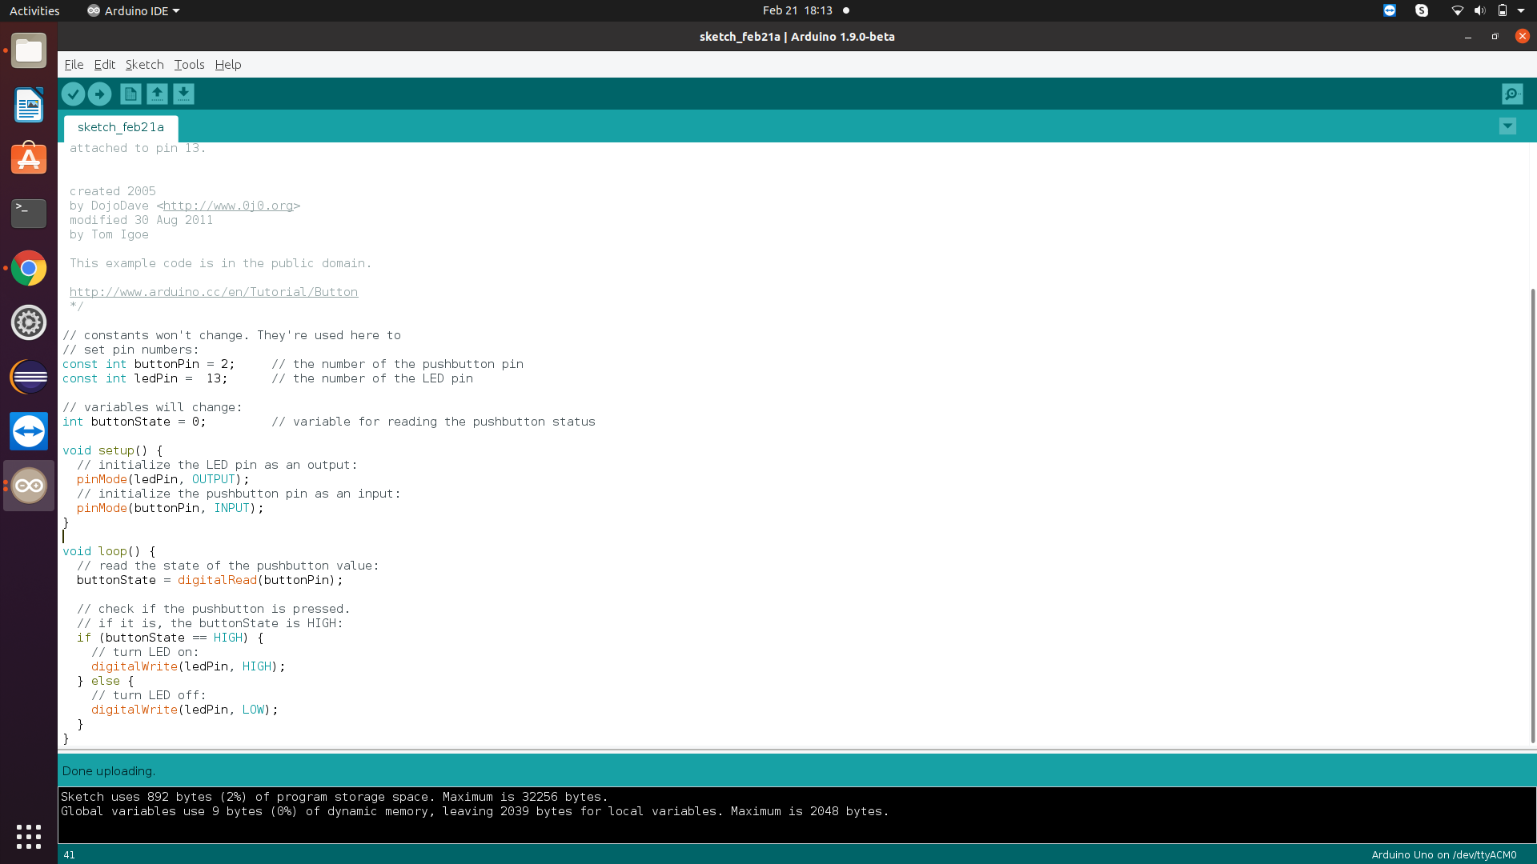

Slide 17

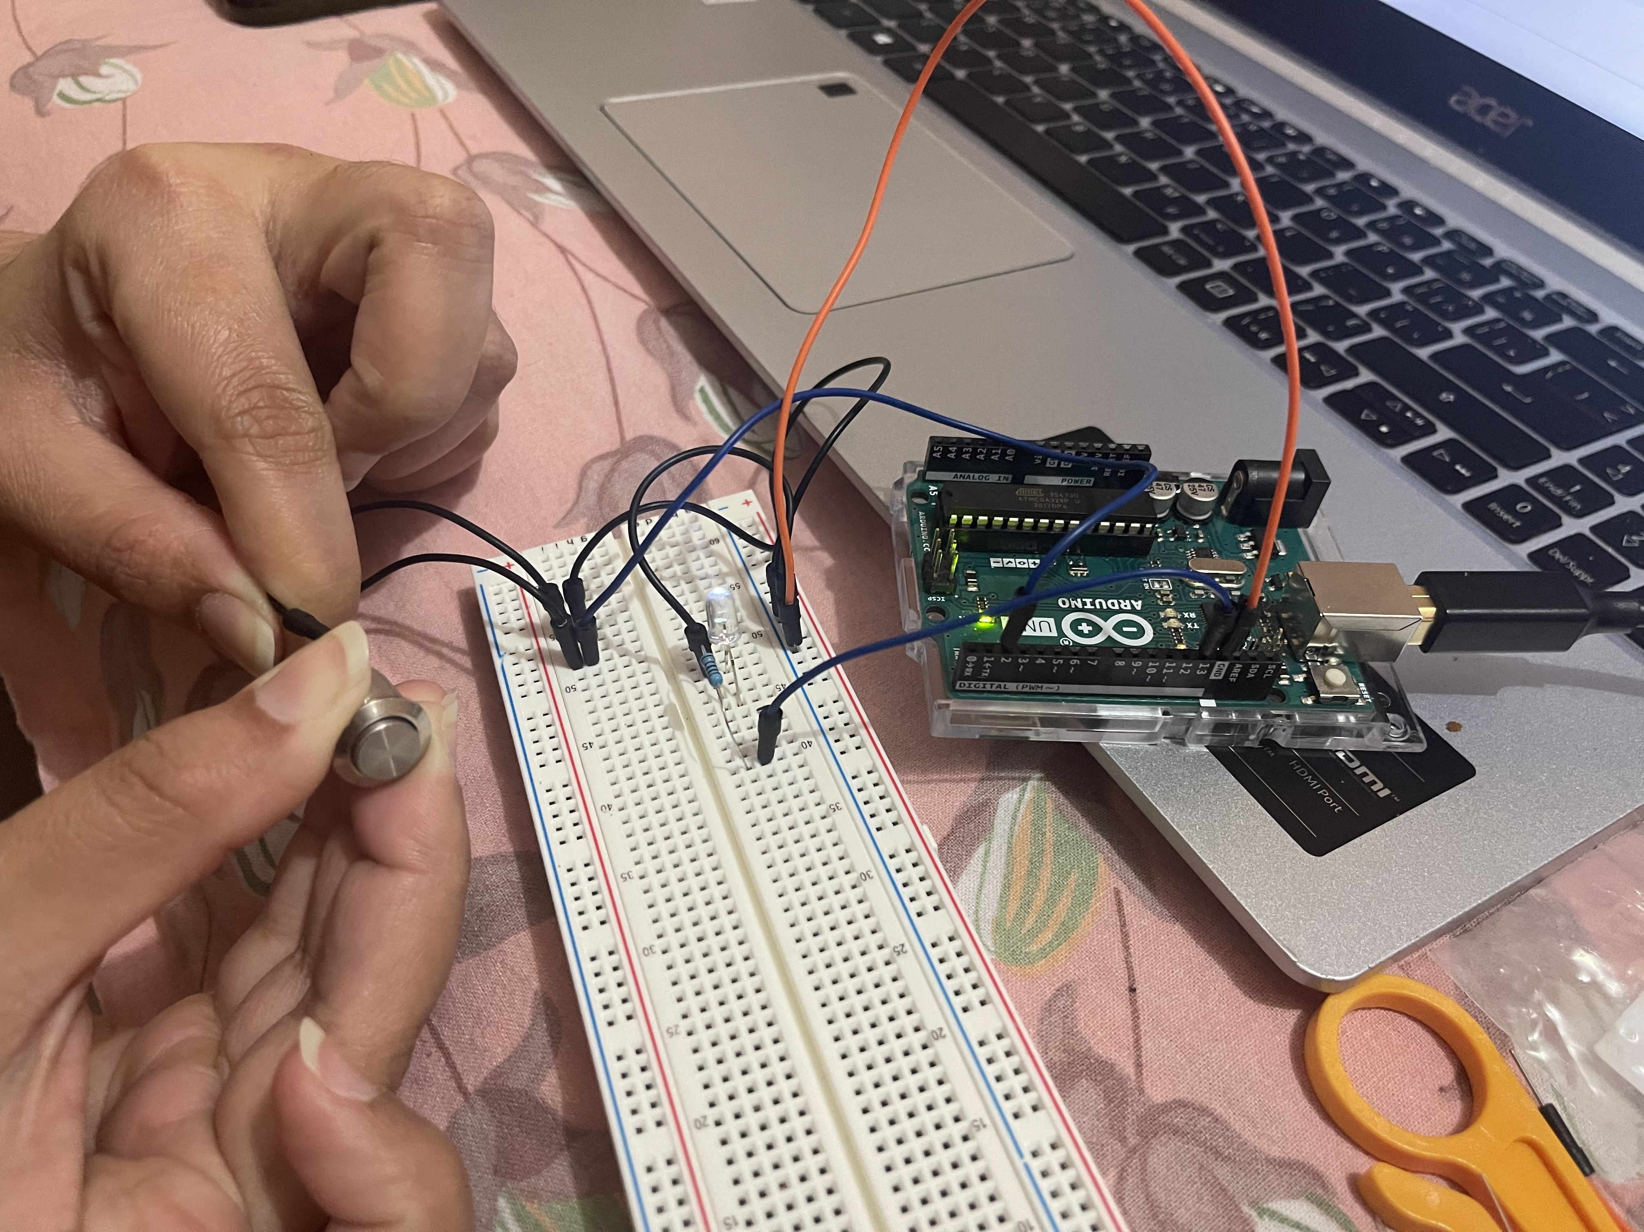

Slide 18
TESTING OF MULTIMETER
Multimeter is a tool which is used to measure the voltage, current and resistance of electrical components. Basically, to check the multimeter is giving the correct reading or not, firstly we need to perform the basic task on the multimeter.

Slide 19
Testing of Multimeter
First step is to connect the red probe to the input slot and the black probe to the common slot and set the center button to the continuity, then connect the ends of two probes with each other. If the multimeter shows 0 value or near to 0 , then the multimeter is good otherwise need to be replaced with the new one.

Slide 20
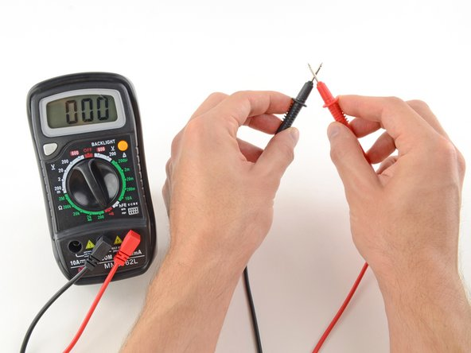
TESTING OF MULTIMETER

Slide 21
References:
Retrieved from Last Minute Engineers, URL: https://lastminuteengineers.com/arduino-keypad-tutorial/
ESP32 module- Retrieved from Random Nerd Tutorials, URL: https://randomnerdtutorials.com/installing-the-esp32-board-in-arduino-ide-windows-instructions/
Beaglebone black- Retrieved from, beagleboard.org URL:http://beagleboard.org/getting-started
Push Button- Retrieved from, Project hub, URL:https://create.arduino.cc/projecthub/glowascii/button-arduino-basics-5ecffc

